Slide 1
YEAR 13 SESSION 2:
CVs & EMPLOYABILITY

Slide 2
PREVIOUS SESSION’S OBJECTIVES
OBJECTIVE 1: To understand what UCAS is and how to apply for university through UCAS.
OBJECTIVE 2: To understand what makes a good personal statement.
OBJECTIVE 3: To make a start on your own personal statement.

Slide 3
CHECK-IN
Your personal statement –
How are you getting on?

Slide 4
SESSION OBJECTIVES
OBJECTIVE 1: To understand how to gain skills and experiences to increase your employability & transferable skills.
OBJECTIVE 2: To understand what makes a good CV and how to create one.
OBJECTIVE 3: To understand how to demonstrate your skills and develop your ‘Personal Brand’.

Slide 5
WHAT ARE TRANSFERABLE SKILLS?
Transferable skills are a core set of skills and abilities, which can be applied to a wide range of different jobs and industries.
They’re usually picked up over time, and can be gained from previous positions, charity or voluntary work, your hobbies, or even just at home.
(Reed.co.uk)
Notes:
2.1
What are transferable skills? https://www.reed.co.uk/career-advice/what-are-transferable-skills/
Transferable skills are a core set of skills and abilities, which can be applied to a wide range of different jobs and industries.
They’re usually picked up over time, and can be gained from previous positions, charity or voluntary work, your hobbies, or even just at home.
Why are transferable skills important?
Although slightly softer skills than those directly related to a position, transferable skills are incredibly valuable to employers.
Not only do they show that you’d be a good fit for the team, they can also demonstrate what a candidate can bring to a role, and how much they’ve learnt from previous positions or experiences.
So if you’re currently lacking experience in the field you’re looking for work in, transferable skills can be a great way to highlight why you’re right for the role. Examples of when this can be helpful include entry-level positions, and those looking to change careers.

Slide 6
CAN YOU THINK OF ANY TRANSFERABLE SKILLS?
Teamwork
Organisation
Listening
Written communication
Verbal communication
Prioritisation
Time management
Notes:
Time management
Time management is a vital skill for any role, that not only proves you can work to deadlines – but also that you’re able to complete tasks in the most time-effective way, create to-do-lists, delegate, ask for help, and break up projects accordingly.
Whether it’s that you’ve had experience stacking shelves within a set time in a retail store, you’ve completed projects within a deadline, or you’ve carried out construction work that met the time-sensitive needs of a client, you’ll have at least one example of time management to reference in your CV.
Prioritisation
Prioritising tasks effectively is essential if you want to get anything done, on time, and to a high standard. That’s why it’s a key skill that the vast majority of employers value.
Prove you’re able to assess your workload, adjust your schedule, and organise tasks in order of importance by giving tangible examples in your CV. For example, it could be that your ability to be ruthless and say no to certain tasks enabled you to complete others which had a higher level of importance, or you implemented time saving techniques to get small tasks done faster (e.g. spreadsheets, templates).
Listening
Let’s face it, everyone is likely to have good listening skills, no matter where your experience lies. This means demonstrating them in your CV should be easy.
Think about times where your ability to listen well resulted in a positive outcome – whether it’s that you’re great at following instructions (which meant your work was done specifically to a client’s requirements), you’re able to absorb knowledge quickly when taught (whether it was in a meeting, at university, or anywhere else), or you delivered excellent customer service by listening carefully to a customer’s needs.
Communication
Although it’s particularly important in customer facing industries, good communication is an extremely versatile skill that’s an important part of every role – which contributes to the smooth running of any workplace.
Luckily, that means everyone has it. Examples of communication skills could range from instances where you communicated with a customer or client to fulfil their needs or resolve a problem, to times where you worked together with your colleagues to achieve a joint goal.
Teamwork
Teamwork skills involve the ability to work with others towards a common goal. Effective teamwork requires several other qualities such as empathy, active listening and strong communication. Providing successful teamwork examples during interviews can help employers understand how you’ll work with others in their company.
Organisation
A well-organised person has a strong, neat structure in their workspace, tasks and relationships. Organised employees typically meet deadlines, communicate with others in a timely manner and follow instructions well. Employers can trust organized workers to meet deadlines, take notes and ensure projects are completed efficiently.

Slide 7
CAN YOU THINK OF A WAY THAT YOU COULD ENHANCE YOUR TRANSFERABLE SKILLS?
Notes:
Ask the students what transferable skills they think they have?
How have they got these skills?
How can they be improved?

Slide 8
PART TIME WORK
Whilst in education there is a lot to think about. You’ll be juggling deadlines for presentations, exams and coursework, as well as attempting to maintain a life outside your studies.
Managing your time can be difficult and the decision to add another component into the mix can be daunting. But, securing a part-time job alongside your studies can be beneficial.
Benefits of working part time:
Stepping out of your comfort zone
Learning new skills
Meeting new people
Improving your CV
Earning money
Notes:
Whilst in education there is a lot to think about. You’ll be juggling deadlines for presentations, exams and coursework, as well as attempting to maintain a life outside your studies.
Managing your time can be difficult and the decision to add another component into the mix can be daunting. But, securing a part-time job alongside your studies can provide several benefits.
1. Challenging yourself
Stepping outside the world of education and venturing into the unfamiliar world of employment is likely to push you outside of your comfort zone.
Submitting job applications, attending interviews and assisting customers are all new experiences. And, they can help you to develop confidence and an understanding of other people’s needs.
There are many ways in which employment is different from education. One of which is that it’s often unpredictable. When something goes wrong at work, maybe a delivery is late, or if a customer is unhappy, you need to think on your feet to resolve the issue.
These situations teach you how to problem solve and be a more resilient and adaptable person. This means you’re able to bounce back quickly in challenging situations. Resilience is an important strength to have in all aspects of your life. So developing it whilst working part-time is certainly worthwhile.
2. Developing transferable skills
Transferable skills, sometimes known as soft skills, aren’t measurable and don’t relate to a specific profession. Instead they are skills which are relevant to most, if not all, jobs and are therefore highly desirable.
Communication, teamwork, commitment, organisation and multi-tasking are some examples of transferable skills which you are likely to gain from a part-time job.
When you finish studying and look for a full-time job, often you will see these skills listed in the personal specification section of a job description. Being able to demonstrate how you’ve developed and used these skills will show employers that you’re a well-rounded candidate.
3. Meeting new people
When studying you might only meet people who are like you. Your cohort are likely to share very similar interests, as you’re all studying the same subject.
However, through your part-time job you may encounter people from all walks of life. Working in a diverse team enables you to collaborate on new ideas, learn from your colleagues’ experiences and develop a better understanding of people from different backgrounds.
You’re likely to become a better communicator who is sensitive to the views and feelings of others. Keeping in contact with colleagues is a great way to keep in the loop. And, they might think of you when they hear about a brilliant opportunity or a vacancy that you’d suit.
Always leave a job on good terms with both the employer and your colleagues. After all, you never know when you might run in to them on a professional basis in the future.
4. Improving your CV
Over 45% of employers state low numbers of applicants with the required skills as the primary reason they struggle to fill vacancies, whereas only 13.7% cite lack of qualifications as a leading factor.
Many employers don’t even ask for a specific degree. Even if you’re studying in an area with a very clear career path ahead of you, or you’re looking to enter an industry which suffers from a lack of qualified applicants, your grades alone may not be enough to appeal to an employer.

Slide 9
WHERE TO FIND PART TIME WORK
Speak to your school careers advisor
Look at local jobs boards
Reed.co.uk
Monster.co.uk
Targetjobs.co.uk
Totaljobs.com
Jobsite.co.uk
Indeed.co.uk
Notes:
There are lots of different places to find local work, using these websites you can filter for what kind of jobs you would like to look at, such as retail work or waiting staff.

Slide 10
VOLUNTEERING
Whether its helping to care for endangered animals abroad or becoming a football coach for your local team, there are many volunteering opportunities available!
Benefits of volunteering:
It boosts your education/job applications
It enables you to learn new skills
You can try out different careers
You can meet new people
It can help you network
You are helping others
Notes:
https://www.whatuni.com/advice/guides/ultimate-guide-to-student-volunteering/76054/
While it’s incredibly tempting to spend all your precious free time binging on Netflix or Instagram, there’s something you can do that is a) just as enjoyable and b) has a whole host of benefits that could potentially transform your life. There are many great reasons why you should consider doing some volunteer work whilst you are studying at college or university. Here's just a few of them...
It Boosts Your University Application and CV
Having volunteer work down on your CV can really give you a boost with potential employers. It’s also a pretty good thing to have on your university application form.
It makes you look proactive, reliable, and enthusiastic - all traits employers look for in employees.
Volunteering also helps you gain valuable experience to help you in your chosen career. For example, if you are studying medicine volunteering in a hospital or care home will give you valuable real-world experience. Or working for a charity organising events or collecting donations could help you if you’re studying for a marketing or sales roles.
Plus, it gives you other real-world ‘soft skills’ that employers love to see on your CV, including team-work skills, working with highly confidential information, communication skills, and leadership skills.
You may even find you can fast-track your career (and your salary!) to a higher level than other graduates – especially if you volunteer in positions where you are actively managing or leading others.
It Lets You Learn New Skills Whether it’s developing your cooking skills with Foodcycle in the UK, or learning carpentry by helping to build schools in Ghana – volunteering enables you to learn skills that in most cases you’d have to pay to learn otherwise.
Plus, as mentioned above, you’ll learn transferable skills that employers are looking for. Not only that – but you may find you can pick up skills that enable you to apply for careers that you didn’t think you could before.
Talking of which…
You Can Try Out Different Careers Thinking of a career in teaching, but not sure its right for you? Fancy yourself as the next Jamie Oliver, but worried you don’t have what it takes?
Volunteering can help you there. It lets you test out new and sometimes completely different jobs to the one you are studying towards gaining.
You never know, you could end up enjoying the work you do in your volunteering role so much that you get inspired to choose a completely different career path to the one you’d already planned for yourself.
And in some cases, volunteering can lead to paid work if the organisation you are working for thinks you are good enough to offer you a job.
You Can Meet New Friends and Experience New Cultures When you volunteer – especially abroad in remote place – you are often part of a close-knit group who spend a lot of time together. Creating all those amazing shared memories of making the world a better place can create a strong bond between you and your fellow volunteers.
Even if you are volunteering in the UK, you’ll get to meet a whole bunch of new people, of all ages and from a variety of different backgrounds. It’s an opportunity to learn new languages, try new foods and learn about the customs and cultures of others – all things that can enrich you as a person.
It Can Help You Network
It’s not just new friends that you can meet and bond with while volunteering. Volunteering opportunities in many cases are open to people of all ages to take part in.
You may find yourself volunteering alongside people who are already really successful in their own careers – people could potentially help mentor you, be a reference on your CV, or even help you find a job when you graduate from uni.
By taking part in a variety of volunteering projects you could build a little black book full of handy business connections that may come in handy in the future.
Helping Others Last, but certainly by no means least, by offering your time and effort you can make a real difference to someone’s life. Whether that’s helping a community in Africa get clean drinking water by building a well in their village, or helping a fellow teenager struggling with mental health issues – you can make a change for the better in so many ways.
Volunteering really is a great thing to do with your spare time – both for yourself and for others in need. It really is a win-win for all.
And don’t forget – you don’t need to give up all of your spare time to sow and reap the benefits of volunteering. If you only have an hour or two a week – you can find an opportunity to volunteer and make a difference.

Slide 11
WHERE TO FIND VOLUNTEERING OPPORTUNITIES
Speak to your school careers advisor
Look at local volunteer boards
Sport clubs
Charities
Local council websites
Notes:
There are lots of different places to find volunteering opportunities. Some opportunities are offered all over the country, such as big charities like British Heart foundation and Samaritans. Most football clubs also have volunteer opportunities.
British Heart Foundation
The British Heart Foundation (BHF) is a charity organisation in the United Kingdom. It funds research to beat heartbreak from heart and circulatory diseases and their risk factors.
There are opportunities in fundraising, helping our in charity shops and other various support roles.
Wolverhampton Wanderers FC
Football Clubs
Volunteers are essential in football. Around 400,000 people keep the game running through various club roles, such as welfare officers, club secretaries and treasurers.
By volunteering, not only are you helping others, but you are also opening up opportunities to move into full-time roles at professional football clubs or organisations in sport in the future. You can volunteer in events, catering and sport roles
Samaritans
Samaritans is a registered charity aimed at providing emotional support to anyone in emotional distress, struggling to cope, or at risk of suicide.
You could become a listening volunteer, helping us to answer calls and messages from people who need some support. And there are a range of other opportunities available too.
Birmingham Voluntary Service Council (BVSC) - https://www.bvsc.org/volunteering
Provides support to volunteers, voluntary groups and civil society in the City of Birmingham.
There are hundreds of volunteering vacancies available across the city with lots of different charities including sports coaching, caring, administration, research, youth work, conservation to name a few
Walsall Council : https://go.walsall.gov.uk/community_development_voluntary_organisations
All local councils advertise their own volunteering opportunities
There are a number of voluntary organisations within Walsall:
One Walsall
Walsall Citizens Advice Bureau
Walsall Victim Support
Relate Walsall
First Base Walsall
Do IT https://do-it.org/
Is a tool which allows you to search for volunteering opportunities in your local area.
These can range from: a retail assistant in a charity shop, a café volunteer assistant or a an activity assistant volunteer where volunteers support disabled children during fun and challenging activities to get the most out of them and to ensure they have great time.

Slide 12
WHERE TO FIND COURSES
Future Learn offer courses in a diverse range of subjects such as:
Improving Interview Technique,
How to succeed at interviews
Managing your online identity
Barclays Life Skills offers interactive tools, films and activities for you to use now. They offer support with:
Building confidence and being more assertive
How to succeed in the workplace
Developing enterprise and business skills
Google Digital Garage offers a range of free learning content designed to help your career. Such as:
Build confidence with self promotion
Speaking in public
Influencing people
Notes:
FutureLearn https://www.futurelearn.com/
Browse our course list to find something that you’d like to learn about. We have courses in a diverse range of subjects and are always adding more. Courses vary in length. Most are six to ten weeks long but we also have some shorter two and three week courses.
Barclays Life Skills https://barclayslifeskills.com/young-people/
How LifeSkills can support you right nowBarclays want to do all we can to continue supporting learners like you, as well as your parents and teachers.
Despite the challenges we’re all facing, it’s important to use this time to keep building your skills, and there are lots things you can still do to be prepared for the future.
Are you ready to think about the areas you might like to develop in further? Visit our website for more courses
Why learn with Google Digital Garage https://learndigital.withgoogle.com/digitalgarage
The majority of the courses are free, and approved by industry experts, top entrepreneurs and some of the world’s leading employers. So you can be sure that you’re learning up-to-date, real-world skills that help you reach your goal.
Encourage students to go and look into them
Do a Printable PDF with all the links on (signpost sheet)

Slide 13
CV (Curriculum Vitae)
When do you use a CV?
What is a CV?
Why is a CV important?
Notes:
2.2
Let’s see what you think – what makes a good CV? And what makes a bad CV? Fire off suggestions!
Sample Responses:
Good CV – Excellent spelling/grammar, contact details, range of skills, accomplishments, qualifications, sells yourself, one or two pages long, well-organised (e.g. bullet points included)
Bad CV – Spelling/grammar errors, missing information, boastful/arrogant comments, negative comments, long paragraphs, boring interests/hobbies, too long/short, formatting errors

Slide 14
CV (Curriculum Vitae)
GOOD CV
BAD CV
Notes:
Good CV – Excellent spelling/grammar, contact details, range of skills, accomplishments, qualifications, sells yourself, one or two pages long, well-organised (e.g. bullet points included)
Bad CV – Spelling/grammar errors, missing information, boastful/arrogant comments, negative comments, long paragraphs, boring interests/hobbies, too long/short, formatting errors

Slide 15
CV (Curriculum Vitae)
GOOD CV
BAD CV
1-2 pages long
Achievements
Too long/short
Boring
Range of skills
Sells you
Gaps in information
Boasting/arrogance
Well organised
Spelling/grammar
SPAG Errors
Formatting errors

Slide 16
YOUR CV
Visit this website to build a new CV or revamp an existing one:
https://careercompanion.cv-creator.com/users/create
Notes:
Resource Booklet Page 32: 2.2 CV builder
Or IT access for the above site.

Slide 17
YOUR CV
Use the template to construct your own CV!
If you already have one, think about how you could update it, looking at the samples and what we have discussed today.
Notes:
Non-IT

Slide 18
PERSONAL BRAND
What is a ‘Personal Brand’?
A personal brand is how you promote yourself. It is made up of the skills, experience, and personality that you want the world (including employers) to see.
Do you have an online presence? Is it a positive one? Should you think about making certain profiles private?
If you don’t have an online presence, how could you build one to represent who you are and what you’re all about?
Notes:
2.3
With so many jobs being advertised online and employers doing their research on potential employees, having a good personal brand is more important than ever!
Think about what an employer may find if they were to google your name. Do you have an online presence? Is it a positive one? Should you think about making certain profiles private?
If you don’t have an online presence, how could you build one to represent who you are and what you’re all about?

Slide 19
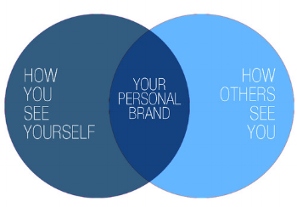
PERSONAL BRAND
Who are you? Offline and Online?
With so many jobs being advertised online and employers doing their research on potential employees, having a good personal brand is more important than ever!
Notes:
Lead conversation onto now that you have a personal brand, who’s going to see it and how are you going to get people to see it?

Slide 20
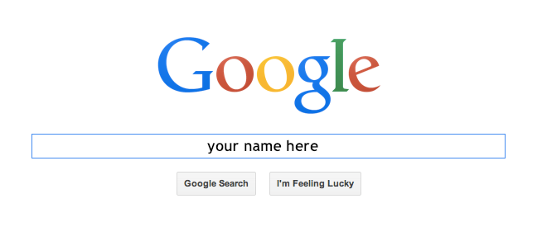
YOUR DIGITAL FOOTPRINT
A digital footprint is all of the information about a person that can be found online.
Have you ever searched your name on Google to see what comes up?
Think about if you’d be happy with the information that is publicly available about you?
What steps should you take to minimise the information that can be found about you online?
70% of employers use social networking sites to research job candidates before hiring!
Notes:
Use the ‘googling yourself’ as a discussion point, not an activity!
Things to consider
Do you have an online presence? Is it a positive one? Should you think about making certain profiles private?
If you don’t have an online presence, how could you build one to represent who you are and what you’re all about?

Slide 21
COMMON MISTAKES
Complaining about job or boss
Sharing things prematurely (breaching confidentiality)
Copyright issues (copying content)
Poor spelling/grammar and using texting language
Posting inappropriate things or photos
Mocking others (i.e. trolling)
Notes:
For EO: Keep this section quite informal – not too heavy. The reason why we have included this section is to have an informal conversation about some potential mistakes individuals make online
Complaining about employment – a bit obvious but it’s might be easy to forget…
Sharing things online/ to the public before it should be shared could be a breach of confidentiality. An example of this is broadcasting a job offer before it has been finalised, or perhaps showing a product before it’s release date?
Copyright issues – avoid sharing content or posting things that aren’t your own. For example, posting a song on Youtube might go against Youtube copyright policy.
A Jobvite survey found that 66 percent of employers look negatively upon poor spelling and grammar on social media. It’s easy to revert to slang on social media but try to keep your pages as professional as possible.
Inappropriate examples: Alcohol, drugs, weapons etc.
Avoid mocking others, especially in a professional context such as customers. Several Internet stories involve waiters who have taken photos of poor tips and posted them online only to get fired for doing so.

Slide 22
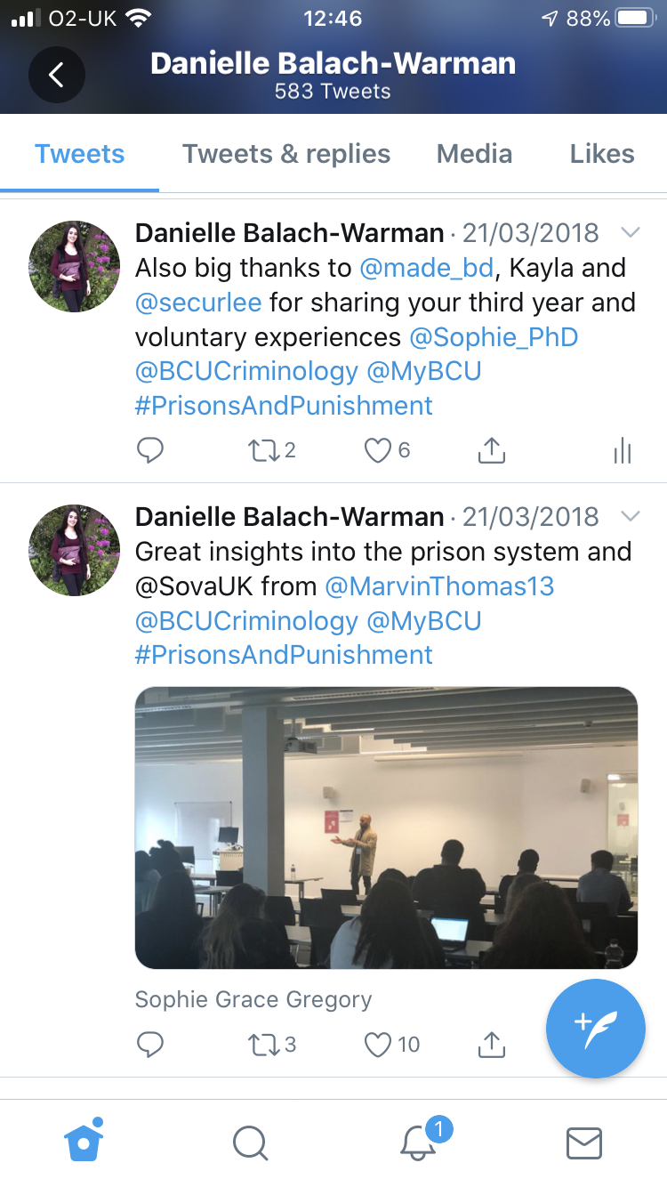
EXAMPLE
Joe Bloggs
What do you notice about the following tweet?
What might be the implications of what Joe Bloggs has tweeted?
If future employers see these posts (they are visible even if deleted off the profile), what might they think?
15/09/2019
Joe Bloggs @JoeBlog…
My managar has dun it again! Sick of her… All im tryna do is live a quite life and do my job. She on my back 24/7 and wont leave me alone! #Why #MightQuit #CBA
10/10/2019
Joe Bloggs @JoeBlog…
If you’re thinking of applying for a job at my work, I wudnt. Ive only bin working here a month and it the worst! #ForReal
Notes:
Use this example as an opportunity to discuss the potential problems of bad tweets, and other social media posts.
The tweets include many of the common mistakes from the previous slide; complaining about job/ boss, potential copyright issues as the logo has been used, poor spelling/grammar/language.
Implications could include: disciplinary, losing job, loss of reputation. Future employers would be reluctant to consider or employ.
Include any other prompting questions…

Slide 23
EFFECTS ON JOB PROSPECTS
Consider how ‘Cancel Culture’ has become a trend. This is the idea that a person (or collective group) can be “cancelled” — in other words, culturally blocked from having a prominent public platform or career.
Can you think of any examples?
In the same way that this can happen to celebrities, or those with a large social media following such as influencers, there is potential for your social media usage to have an impact on your career.
43% of employers use social media to check on current employees…
Notes:
Consider cancel culture to make it relatable… (I bet they will know of one celebrity that it has happened to). Some appropriate examples may include Kevin Hart…
Alongside the statistic mentioned earlier, 43% of current employers use social media to research job candidates.
What you put out now might not affect you right this second, but it might affect you in the future. Everything in the online world is attached to your name forever. Reinforce… this is a transition from school student to post school student (adulating).

Slide 24
YOUR DIGITAL FOOTPRINT
Key things to remember:
Maintain your social media profiles
Try to think ‘professionally’
Double check privacy settings
It’s not easy to take it back once you press send!
The same applies for sharing content
Create a positive online presence
With this in mind, how do you create your own positive online presence?

Slide 25
YOUR DIGITAL FOOTPRINT
https://www.youtube.com/watch?v=eFnJDjAofck
Notes:
Aspire to HE video about digital footprint and using Linkedin:
https://www.youtube.com/watch?v=eFnJDjAofck

Slide 26
DISPLAYING YOUR PERSONAL BRAND
Notes:
Lead conversation onto ‘now that you have a personal brand, who’s going to see it and how are you going to get people to see it?’
You might want to set up an Instagram page related to the career you want! This could help show future employers that you have genuine interest in the area you focus on, for example if you post photos of nice buildings and explain why you like them in the caption, that would show an interest in architecture.
You could also start a blog! Blogs are free to set up and can be used as a place to express your thoughts, interests and opinions on anything you want! Having a platform like this will help convince employers that you have a real passion for the area you discuss!
You might want to set up a LinkedIn account too! This will boost your personal brand, as it shows you as a professional individual, allowing you to interact with companies/universities/individuals that are in your area of interest.

Slide 27
WHAT IS NETWORKING?
Networking is a deliberate activity to build, reinforce and maintain relationships of trust with other people to further your goals. Professional networking is simply networking focused on professional goals.
Notes:
Networking is showing off your personal brand! It’s meeting and building relationships with others who may be able to help you with your professional goals. So it’s important to have a strong personal brand to help you when networking too!

Slide 28
NETWORKING
‘It’s not what you know, it’s who you know’
Notes:
Ask if they’ve heard of the phrase - ‘It’s not what you know, it’s who you know’ – what could that mean for them?
You all have your own network – people sat in this room with you are part of your network. They even have their own network
Your teachers are part of your network now and will still be once you leave school – how could they help you for your future?
Head of sixth forms and career leads in schools have huge networks of their own built over many years – could someone in their network be useful in you achieving your career goals?

Slide 29
WHY DO PEOPLE NETWORK?
To gain access to information and insider knowledge.
To establish new professional relationships and to strengthen existing relationships.
To make sure other people know who you are, what you do, how you do it and what you want to achieve by doing it.
Self promotion.

Slide 30
TOOLS FOR NETWORKING
Did you know... around 85% of job positions are filled through networking?
It’s never too early to start ‘connecting’ with people and building up your professional networks!
LinkedIn is a social media networking platform that focuses on professional networking and career development.
Notes:
The most important tool for networking is you!
Did you know.. around 85% of job positions are filled through networking – ‘it’s not what you know, it’s who you know!’
Remember, networking involves your personal brand i.e. LinkedIn – so utilise all the online tools available to you!
How can you network your personal brand?
Meeting people, being friendly and having good interpersonal skills is what makes people like you – maybe even enough to build a professional working relationship with you!
LinkedIn is a social media networking platform that focusses on professional networking and career development
Basically... it’s the work version of Facebook!
It’s never too early to start ‘connecting’ with people and building up your professional networks, especially if it means building a positive personal brand online!

Slide 31
INDEPENDENT ACTIVITY
TRY GOOGLING YOURSELF!
THINK ABOUT WHAT RESULTS COME UP AND IF YOU SHOULD MAKE ANY OF YOUR PROFILES PRIVATE!

Slide 32
@aspiretohe

