Slide 1
YEAR 11 SESSION 5:
PREPARING FOR YOUR NEXT STEPS

Slide 2
LAST SESSION
OBJECTIVE 1: Understand how to make the most of your summer.
OBJECTIVE 2: Be aware of professional etiquette.
OBJECTIVE 3: Comprehend what a CV is and how to write one.

Slide 3
CHECK-IN
YOUR CV
Did you manage to complete the CV template?
What did you struggle with? What did you find easy?
Remember: See me for any help with your CV or applications!

Slide 4
SESSION OBJECTIVES
OBJECTIVE 1: Understand what you need to prepare for FE.
OBJECTIVE 2: Be aware of the common HE barriers and misconceptions.
OBJECTIVE 3: Comprehend the benefits of HE.

Slide 5
PLANNING FOR FE
Notes:
Resource Booklet Page 57: 5.1 Preparing for Year 12 checklist
5.1
Planning for FE –
Plan your route to your FE destination
Research your options for support e.g. bus pass, tutor, funding etc.
Buy professional wear
Create a revision timetable
Complete the check-list in the Resource Booklet in August/September after year 11.

Slide 6
BARRIERS & MISCONCEPTIONS
Are you worried about HE? Maybe you think you can’t afford it? Or there are some other reasons why you don’t think you can go to university or do an apprenticeship?
We’re going to debunk these myths and prove that anyone can go into HE!
Notes:
5.2 - Barriers & misconceptions, myth buster (HE)

Slide 7
FAMILY FORTUNES
What is the most common reason for people not going into HE?
Too expensive
Not academic enough
Unaware of the variety of courses available
Don’t want to move away from home
Scary!
Notes:
Discuss all answers and respond to any questions from students.

Slide 8
STUDENT FINANCE
You don’t have to pay your course fees up front!
TUITION FEE LOAN
A maintenance loan can help to cover your living costs.
MAINTENANCE LOAN
These loans do not need to be paid back until your have finished university and are earning a set amount.
REPAYMENT
Notes:
Get students to guess the definitions of these terms. Discuss with them and address any concerns the students have.

Slide 9
STUDENT FINANCE
Usually reward students who are outstanding in a subject, sport or musical instrument.
SCHOLARSHIPS
Usually awarded based on personal circumstances, or if the student comes from a low-income household.
BURSARIES
If you are eligible for scholarships, grants or bursaries, you won’t have to pay them back!
REPAYMENT
Notes:
Get students to guess the definitions. Are they obvious? Discuss what these are and why they’re relevant. See handbook for examples of University of Wolverhampton scholarships/bursaries/grants.

Slide 10
FAMILY FORTUNES
For those going to university, what worries them the most about Student Finance?
Not being able to pay it back
Never earn enough to repay and have a good quality of life
Application process
Affect credit rating
Passing debt onto (future) children
Notes:
Discuss all answers and respond to any questions from students.

Slide 11
STUDENT FINANCE
Only pay it back when you earn over £27,295
You’ll repay 9% of your income over the threshold
No debt will be passed on to children and your credit rating will not be affected!
If your income goes below the threshold you’ll stop repaying
After 30 years, your repayments will be cancelled
Notes:
Discuss all answers and respond to any questions from students.

Slide 12
STUDENT FINANCE
Answer the following question:
If you were earning £25,000 a year following your university studies, how much money would you pay each month to repay your loan?
6-inch Meatball Marinara Subway (£3.59)
C) A KFC Chicken Zinger Burger (£4.79)
B) A free sample from a shop in town (FREE)

Slide 13
STUDENT FINANCE
Answer the following question:
If you were earning £30,000 a year following your university studies, how much money would you pay each month to repay your loan?
Sky TV and Superfast Broadband (£39)
1 adult ticket to watch a Wolverhampton Wanderers F.C. home game (£41.50)
C) 6.5 x 20 piece McNugget share boxes (£37.50)

Slide 14
FAMILY FORTUNES
What are the benefits of apprenticeships?
Earn while you learn
Receive recognised qualifications
Gain independence
Gain real work experience
Build good rapport with a company
Notes:
Discuss all answers and respond to any questions from students.

Slide 15
UNI VS APPRENTICESHIP

Slide 16
FAMILY FORTUNES
Why do students choose to move away from home for HE?
Independence
Live with friends
No commute
Learn to manage money
Learn how to cook
Notes:
Discuss all answers and respond to any questions from students.

Slide 17
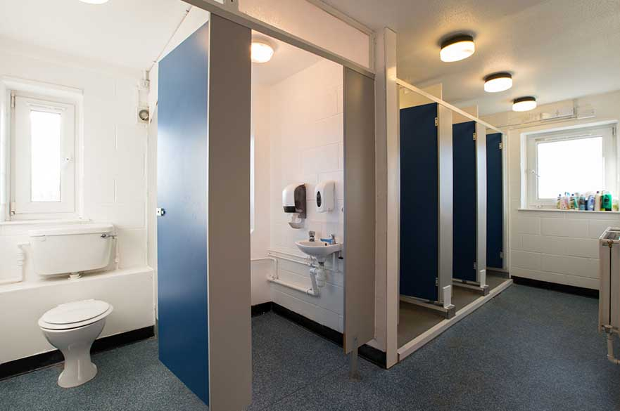
ACCOMMODATION
Shared Bathroom
Pro: Cheapest option and usually a bigger bathroom, or even 2 bathrooms!
Con: Sharing a bathroom with strangers (who will soon become your friends)!
Notes:
Talk through different options, explain that they will usually have to apply for multiple and may not get there first choice…
Emphasise that each university is different and they should do research to find their preference!

Slide 18
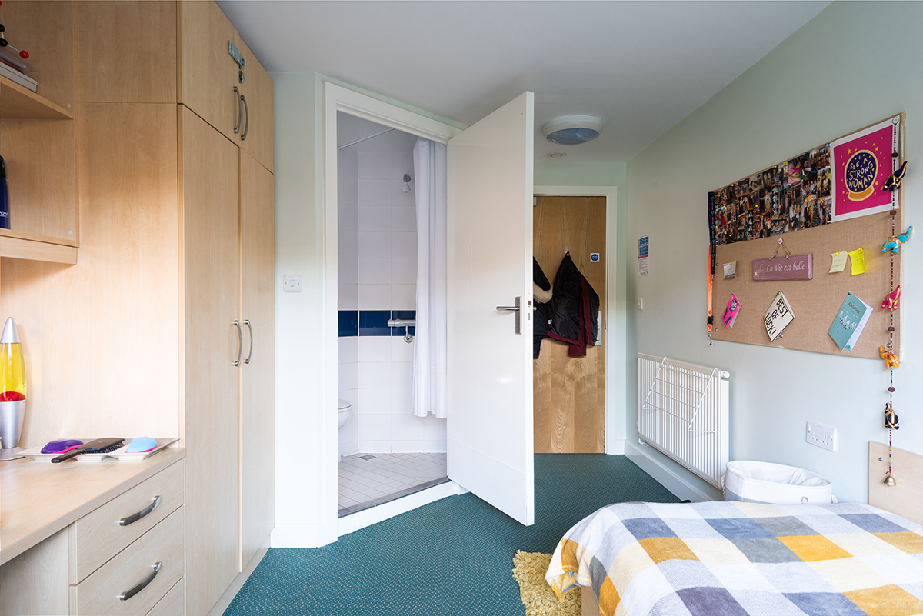
ACCOMMODATION
En-Suite
Pro: Most popular as you have your own bathroom but still share the common areas with other students.
Con: More pricey than shared bathrooms.
Notes:
Talk through different options, explain that they will usually have to apply for multiple and may not get there first choice…
Emphasise that each university is different and they should do research to find their preference!

Slide 19
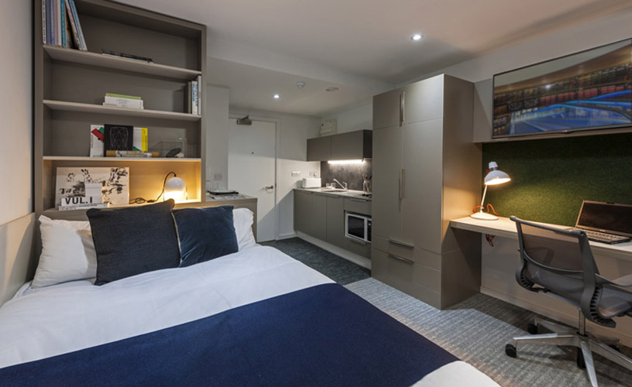
ACCOMMODATION
Studio Flat
Pro: Privacy and luxury! All the space to yourself and no need to share.
Con: PRICEY. It may also be more difficult to make friends.
Notes:
Talk through different options, explain that they will usually have to apply for multiple and may not get there first choice…
Emphasise that each university is different and they should do research to find their preference!

Slide 20
FAMILY FORTUNES
Why do students go to university?
Job prospects
Gain independence
Social life
Travel opportunities
Access to funding
Notes:
Discuss all answers and respond to any questions from students.

Slide 21
BENEFITS OF HE
Join a Sports team
Join a Society
Networking
Develop independence
Higher level of employability
Travel
Make new friends
Notes:
Resource Booklet Pages 58-59: 5.3 Benefits of HE and recap quiz
5.3
Ask students what they think each image represents, text is set up for animation.
Other things to consider:
Try new things
Learn more about a subject you’re passionate about
Opens the door to more opportunities such as work experience or study abroad
Chance to do a placement
Access to materials related to subjects/hobbies
Enact change through charity work or the Students’ Union

Slide 22
RECAP QUIZ
It’s time to test your knowledge!
Can you remember everything we’ve covered in your sessions this year so far?
Answer the next 10 questions as accurately as possible!

Slide 23
RECAP QUIZ
WHAT IS THE DEFINITION OF ‘HE’?
Notes:
Higher Education – Optional, after 18.

Slide 24
RECAP QUIZ
WHAT IS THE DEFINITION OF ‘FE’?
Notes:
Further Education – Compulsory, after 16.

Slide 25
RECAP QUIZ
NAME ONE THING FROM YOUR Y11 CHECKLIST
Notes:
Achieve target grades in GCSEs
Create revision timetable
Create a personal statement for applications
Apply for next steps (college/sixth form/apprenticeships)
Create a CV
Sign-up to an extra-curricular activity
Complete part-time work or volunteering

Slide 26
RECAP QUIZ
NAME A BENEFIT OF HE
Notes:
Independence, travelling, degree etc.

Slide 27
RECAP QUIZ
NAME 2 POST-16 OPTIONS
Notes:
College, sixth-form or apprenticeship.

Slide 28
RECAP QUIZ
WHAT IS A PROSPECTUS?
Notes:
A physical or online book listing information about courses and information for an institution such as college or university.

Slide 29
RECAP QUIZ
WHAT SHOULD YOU TAKE WITH YOU TO AN INTERVIEW? NAME 3 THINGS
Notes:
Pen, notebook, CV, questions for interviewer, water, official documentation.

Slide 30
RECAP QUIZ
NAME AN IMPORTANT SKILL TO UTILISE IN AN INTERVIEW
Notes:
Confidence, communication, team work for group interview, leadership, initiative, being proactive.

Slide 31
RECAP QUIZ
WHAT IS A ‘PERSON SPECIFICATION’?
Notes:
Usually used for full-time jobs to describe essential and desirable criteria for a role.

Slide 32
RECAP QUIZ
WHAT IS A COMMON BARRIER OR MISCONCEPTION OF HE?
Notes:
Cost, only for certain types of people, be really clever to go, full-time weeks, doesn’t actually help you with your career, be in debt for the rest of your life.

Slide 33
RECAP QUIZ
WHAT IS THE DIFFERENCE BETWEEN A COVER LETTER AND A CV?
Notes:
Cover letter – Personalised letter explaining why this role is relevant to you and any experience you have.
CV – Details your achievements, experience, and skills.

Slide 34
RECAP QUIZ
WHAT SECTIONS SHOULD YOU INCLUDE ON YOUR CV? NAME 4 SECTIONS
Notes:
Personal statement/introduction
Education
Qualifications
Work experience
Skills/attributes
Hobbies
Driving license, availability etc.
References

Slide 35
FOR NEXT SESSION:
INDEPENDENT ACTIVITY:
What is a Students' Union?
Research into any Students' Union in the UK and let me know what you think and any activities that you would get involved with!

Slide 36
@aspiretohe

