Slide 1
YEAR 10 SESSION 6:
WHAT ARE THE COSTS?

Slide 2
LAST SESSION
OBJECTIVE 1: Understand the difference in timetables.
OBJECTIVE 2: Be aware of UCAS and its support.
OBJECTIVE 3: Comprehend HE support for equality and inclusion.

Slide 3
CHECK-IN
SUPPORT AT UNIVERSITY
What support did you find that a university offers to students?
Do you think it could be improved?
Is there anything missing?

Slide 4
SESSION OBJECTIVES
OBJECTIVE 1: Understand basic knowledge of student finance.
OBJECTIVE 2: Be aware of how to budget successfully.
OBJECTIVE 3: Comprehend the various financial support available in HE.

Slide 5
ICEBREAKER
STUDENT FINANCE
Answer the following question:
If you were earning £25,000 a year following your university studies, how much money would you pay each month to repay your loan?
6-inch Meatball Marinara Subway (£3.59)
C) A KFC Chicken Zinger Burger (£4.79)
B) A free sample from a shop in town (FREE)
Notes:
6.1

Slide 6
ICEBREAKER
STUDENT FINANCE
Answer the following question:
If you were earning £30,000 a year following your university studies, how much money would you pay each month to repay your loan?
Sky TV and Superfast Broadband (£39)
1 adult ticket to watch a Wolverhampton Wanderers F.C. home game (£41.50)
C) 6.5 x 20 piece McNugget share boxes (£37.50)

Slide 7
STUDENT FINANCE
You don’t have to pay your course fees up front!
TUITION FEE LOAN
A maintenance loan can help to cover your living costs.
MAINTENANCE LOAN
These loans do not need to be paid back until your have finished university and are earning a set amount.
REPAYMENT
Notes:
Get students to guess the definitions of these terms. Discuss with them and address any concerns the students have.

Slide 8
STUDENT FINANCE
Income each year before tax | Approximate monthly repayment
£25,000 | £0
£30,000 | £38
£35,000 | £75
£40,000 | £113
Figures correct as of August 2023*
Notes:
For Y10, don’t go into too much detail. Explain the monthly income vs how much the monthly repayment is (link back to opening question). Provide brief overview regarding the percentage and ask students to attempt the maths question at the bottom.

Slide 9
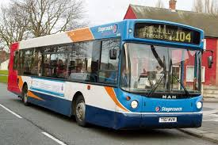
BUDGETING
Could you budget at university?
In this activity, you’ll have to choose between some options as a university student.
You have £150 to spend per week.
Different options have different costs! What will you choose to spend your money on?
Write down the cost of your choices and calculate your total. Did you stay within budget?
Notes:
Resource Booklet Page 35: 6.2 Budgeting
6.2
Handout the budgeting activity from the Resource Booklet

Slide 10
BUDGETING
ACCOMMODATION
Choose 1
University accommodation
Shared accommodation
Living at home
£100 per week
£70 per week
Free?

Slide 11
BUDGETING
FOOD SHOPPING
Choose 1
Marks & Spencer
Asda
Lidl
£40 per week
£30 per week
£20 per week

Slide 12
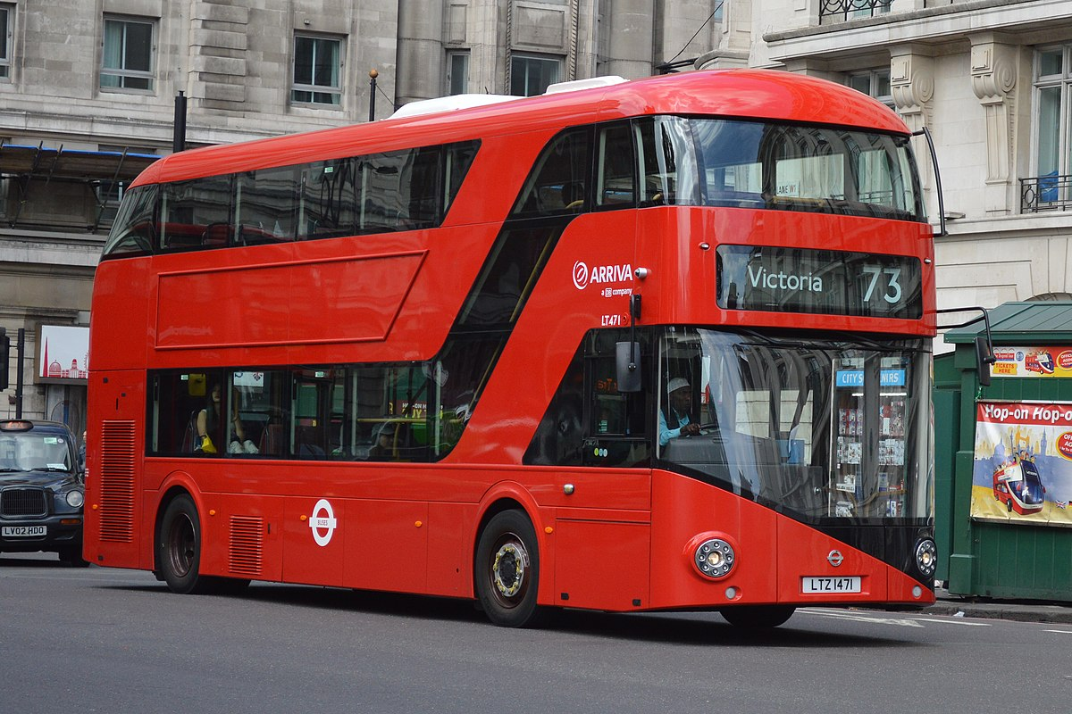
BUDGETING
TRANSPORT
Choose 1
Driving
Bus
Walking
£25 per week
£10 per week
Free

Slide 13
BUDGETING
SOCIALISING
Choose any!
Bowling £10
Theme Park £50
Cinema £20
Festival £100
Students’ Union Quiz Night £15
Meal Out £30

Slide 14
BUDGETING
HOW DID YOU DO?
Accommodation Total:
Food Shopping Total:
Transport Total:
Socialising Total:
What’s your final total? (£150 budget)

Slide 15
BUDGETING
HOW DID YOU DO?
Did you overspend?
What did you find difficult about budgeting?
Is there anything specific you would like to save your money for?
What are your priorities?

Slide 16
STUDENT FINANCE
Usually reward students who are outstanding in a subject, sport or musical instrument.
SCHOLARSHIPS
Usually awarded based on personal circumstances, or if the student comes from a low-income household.
BURSARIES
If you are eligible for scholarships, grants or bursaries, you won’t have to pay them back!
REPAYMENT
Notes:
6.3
Get students to guess the definitions. Are they obvious? Discuss what these are and why they’re relevant.

Slide 17
STUDENT FINANCE
RESEARCH
Where can I find which institutions offer financial support?
Apprenticeships: This is very dependent on your employer. Don’t be afraid to ask during your interview but try to do background research before meeting with them!
Universities: Each institution will offer varied financial support so it’s important to check with them. Some universities may have a special reason e.g. offering a grant because of a special celebration. The best place to visit for general information is UCAS. Visit their ‘Undergraduate Student Finance and Support’ page.
Notes:
Discuss how important it may be for some students to have that additional support, including your own experience. Mention that apprenticeships may not offer as much financial support due to providing a salary. It’s important for students to research their chosen universities as each institution is different but do point them to UCAS for general advice and signposting. https://www.ucas.com/undergraduate/student-life/getting-student-support/undergraduate-student-finance-and-support

Slide 18
16-19 BURSARY
A bursary for education-related costs if you are aged between 16 and 19, studying at a publicly funded school or college in England, or on a training course, including unpaid work experience.
Can be used for clothing, books and other equipment for your course or transport and lunch on days you train or study.
Up to £1,200 depending on your circumstances.
Paid in cash, cheque, travel pass, free meals or equipment. This will vary.
Claim through your school/college. Speak to Student Services.
Speak to me directly for the eligibility criteria.
Notes:
This may be important for their next steps into FE. Discuss the criteria and explain how it can be useful. Identify teachers within the school who can support such as HoY or Student Services if you know them by name. Eligibility criteria can be found here: https://www.gov.uk/1619-bursary-fund/eligibility

Slide 19
RECAP QUIZ
It’s time to test your knowledge!
Can you remember everything we’ve covered in your sessions this year so far?
Answer the next 10 questions as accurately as possible!

Slide 20
RECAP QUIZ
WHAT IS THE DEFINITION OF ‘HE’?
Notes:
Higher Education – Optional, after 18.

Slide 21
RECAP QUIZ
WHAT IS THE DEFINITION OF ‘FE’?
Notes:
Further Education – Compulsory, after 16.

Slide 22
RECAP QUIZ
NAME ONE REASON SOMEONE MAY DO AN APPRENTICESHIP
Notes:
Earn while you learn, specific trade, job prospects upon completion etc.

Slide 23
RECAP QUIZ
NAME A BENEFIT OF HE
Notes:
Independence, travelling, degree etc.

Slide 24
RECAP QUIZ
NAME 2 POST-16 OPTIONS
Notes:
College, sixth-form or apprenticeship.

Slide 25
RECAP QUIZ
WHAT IS UCAS?
Notes:
Where students can research university, student finance, support, apply to institutions etc.

Slide 26
RECAP QUIZ
WHAT IS ‘OPPORTUNITY COST’?
Notes:
Weighing up the benefits and costs of doing something e.g. a hot dog vendor in New York may decrease prices at the end of the day as he would rather make some money than lose out altogether.

Slide 27
RECAP QUIZ
NAME A BUILDING THAT A UNIVERSITY CAMPUS MAY HAVE
Notes:
Students’ Union, Library, Teaching spaces, gym/sports facilities, café etc.

Slide 28
RECAP QUIZ
WHAT IS ‘GRADUATE PREMIUM’?
Notes:
Money graduates earn compared to non-graduates. Approximately £10,000 more per year!

Slide 29
RECAP QUIZ
WHAT IS A COMMON BARRIER OR MISCONCEPTION OF HE?
Notes:
Cost, only for certain types of people, be really clever to go, full-time weeks, doesn’t actually help you with your career, be in debt for the rest of your life.

Slide 30
RECAP QUIZ
WHAT IS A CV?
Notes:
Something given to employers that details your experience, education and any other relevant skills for the role.

Slide 31
RECAP QUIZ
NAME SOMETHING YOU CAN PUT ON YOUR CV
Notes:
CV – Details your achievements, experience, and skills.

Slide 32
@aspiretohe

